Slide 1
Credit Card Dataset for Clustering
Unsupervised ML - Clustering
Karouzos Stelios
Kalantzis Alkis
Rentiniotis Thanasis

Slide 2
Characteristics of selected df
6 months credit card data from 2017, 17 metrics/variables.
~9k active credit card holders, thus adept to data manipulation and clustering techniques.
Credit cards in wide use, but client behavior varies widely, as do available services.
How to gain insights on client preferences, optimize services offered, maximize impact of promotional campaigns, maximize profit, etc… ?
Optimize services-Gain Insights
2

Slide 3
Significant Variables
01
02
03
Account Balance
Credit Limit
Balance Frequency
04
05
06
Purchases
One-off Purchases
Installments Purchases
How frequently the Balance is updated
Amount of purchases made from account
Maximum purchase amount done in one-go
Amount of purchase done in installments
3

Slide 4
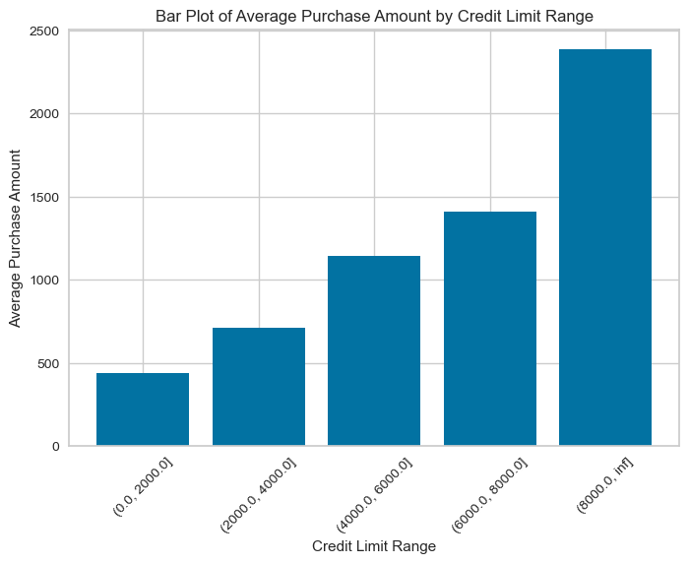
4

Slide 5
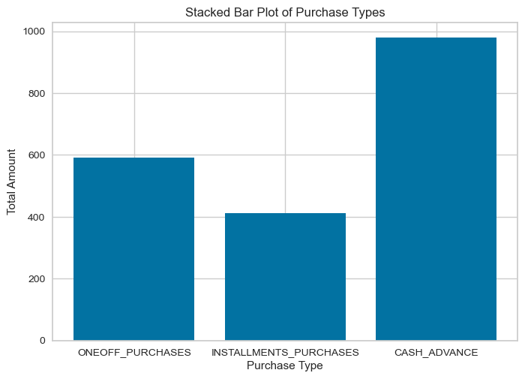
5

Slide 6
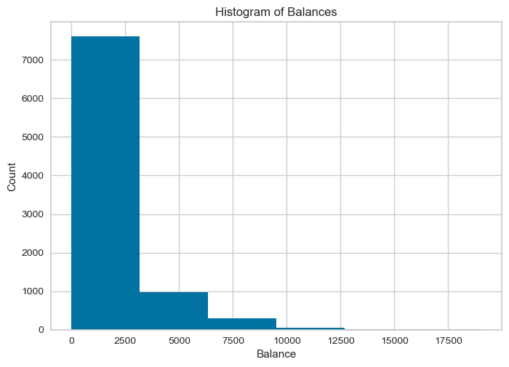
6

Slide 7
Our Pipeline
Data Cleaning-KNN Imputation
EDA
Scaling
K-means-Hierarchical Dendrogram
Outlier Detection
Local Outlier Factor
Standard Scaler
Silhouette Score-ELBOW-PCAnalysis
7

Slide 8
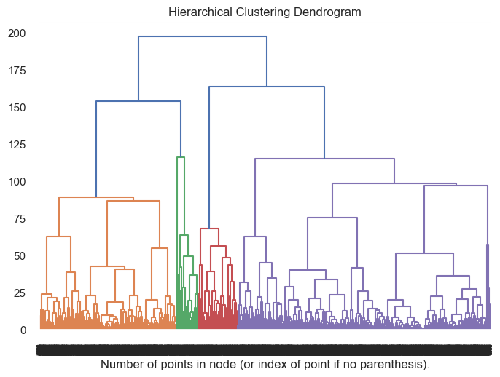
8

Slide 9
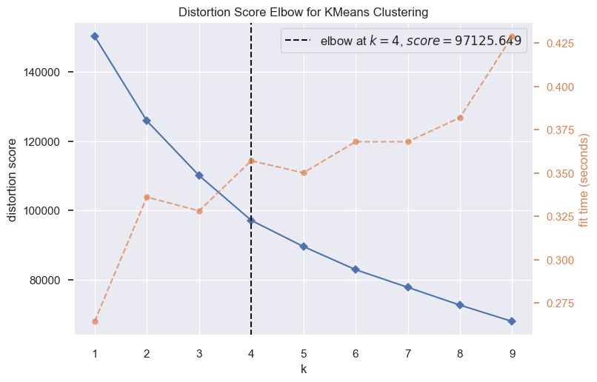
9

Slide 10
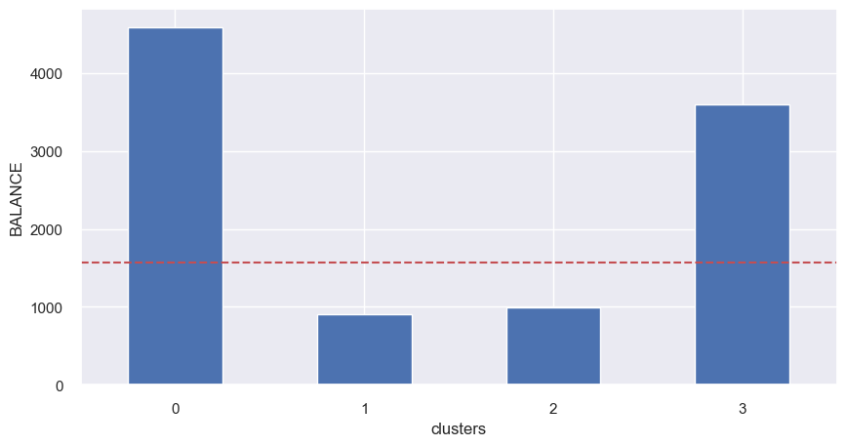
10

Slide 11
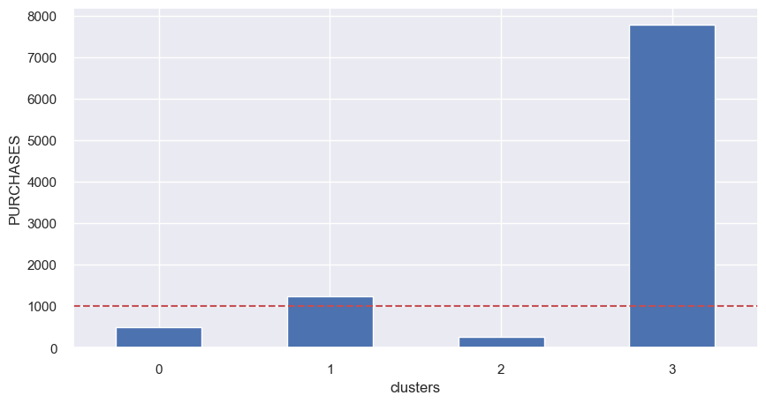
11

Slide 12
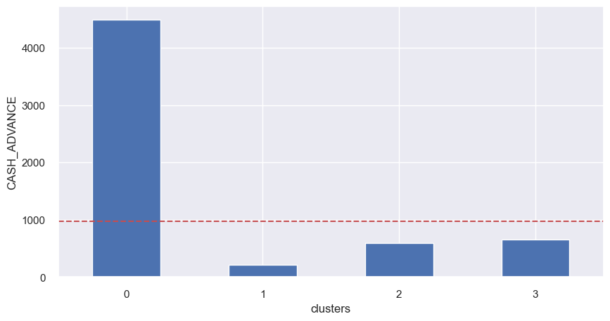
12

Slide 13
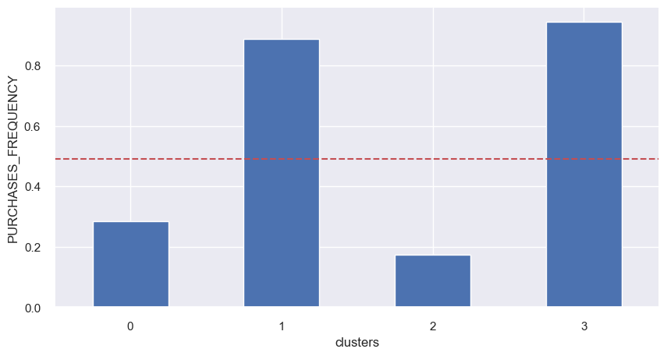
13

Slide 14
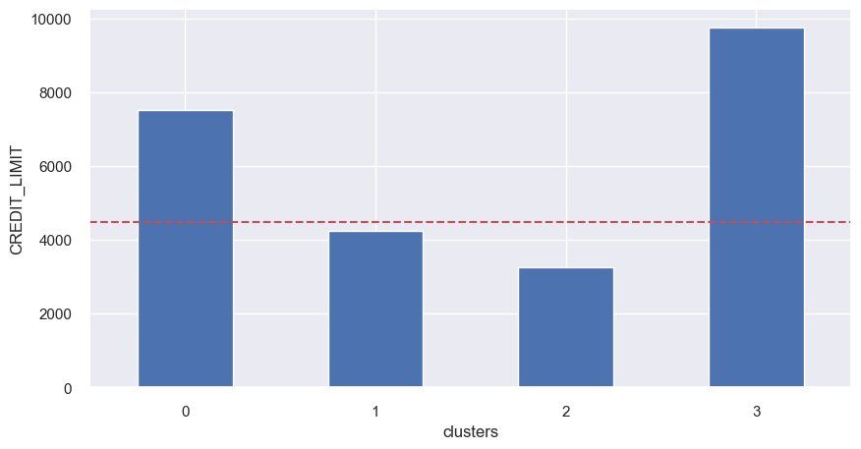
14

Slide 15
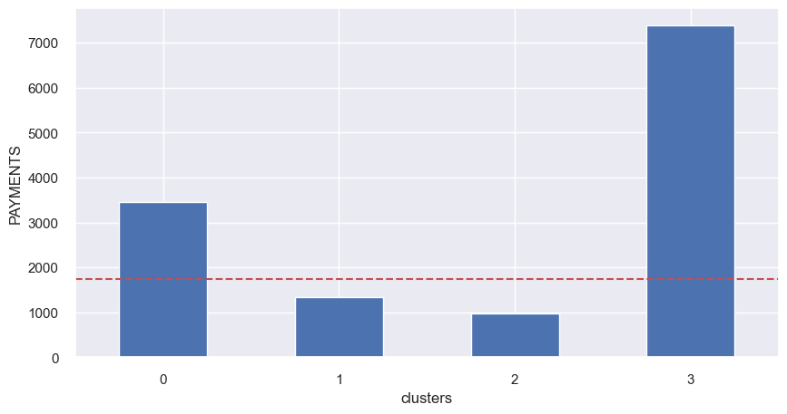
15

Slide 16
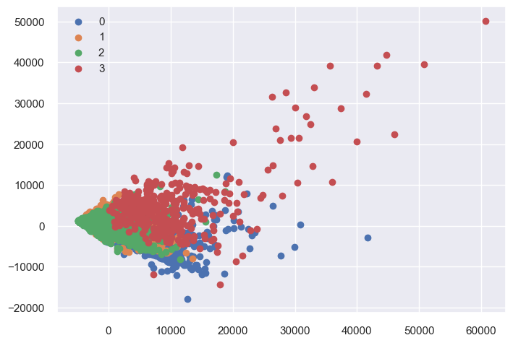
16

Slide 17
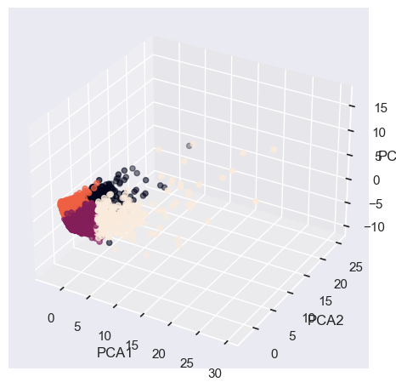
17

Slide 18
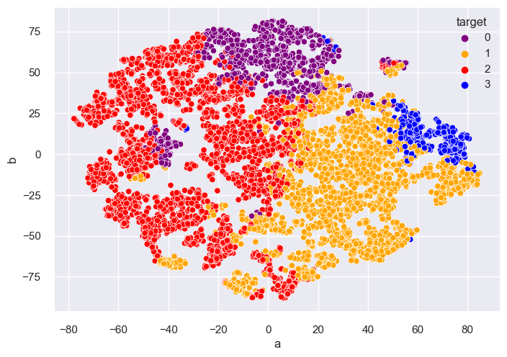
18

Slide 19
Conclusions
Most clients have less than 2’000 USD in their accounts
Higher account balance correlates with higher spending, but relationship is not linear
Despite varying consumer habits and balance, clustering is not straightforward, but segmentation is relevant…
Additional features (gender, age, location, occupation, etc) would be useful
19

Slide 20
Further Work
Different ML techniques may discover additional correlations
Gaussian analysis
6 months is rather short for concrete conclusions
20

Slide 21
Q & A
Thank you for your time!
21

